Slide 1
Chapter 1
Introduction to Savings
Personal Finance
Mr. Brown

Slide 2
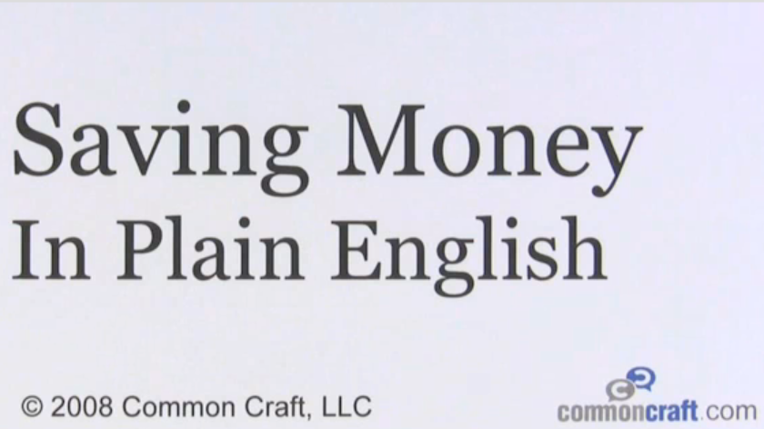
Savings 101
* Be sure to list as many key terms as
you can in your note’s margin!! Who can
record the most?

Slide 3
Saving Basics
Savings is the portion of current income not spent on consumption. Mainly used for long term and short term needs.
  Short Term Needs- immediate future of a year or less
    Emergencies- Unemployment, sickness, accident, etc.
    Social Events- weddings, family gatherings, vacations, etc.
    Major Purchases- car, furniture, electronics, appliances, etc.
  Long Term Needs – future needs greater than a year and usually more costly
    Home Ownership
    Education
    Retirement
    Investing
Rank your most important to least!

Slide 4
How your money grows…
Principal- initial amount deposited into a savings account
Time (term)- amount of time money is invested
  (usually in years or months)
Interest (rate)- money a financial institution pays or charges
  Simple Interest = Principal x Rate x Time
  APY- Annual Percentage Yield- Actual interest rate account pays per year with compounding included
    Truth in Savings Act states APY must be disclosed so that consumers can easily compare products/rates offered between various lending institutions
  Compounding Interest- bank pays $ on principal and previously earned interest
    the more times compounded, the more money you make

Slide 5
The Power Of Compounding
COMPOUNDING 5% ANNUALLY
YEAR | BEGINNING BALANCE | INTEREST EARNED %5 | ENDING BALANCE
1 | $100.00 | $5.00 | $105.00
2 | $105.00 | $5.25 | $110.25
3 | $110.00 | $5.51 | $115.76
COMPOUNDING QUARTERLY (5% ÷ 4 = .0125)
YEAR | BEGINNING | RATE | Q1 | Q2 | Q3 | Q4 | END BAL
1 | 100 | .0125 | 1.25 | 1.27 | 1.28 | 1.30 | 105.20
2 | 105.20 | .0125 | 1.32 | 1.33 | 1.35 | 1.37 | 110.57
3 | 110.57 | .0125 | 1.38 | 1.40 | 1.42 | 1.44 | 116.21

Slide 6
The Power of Compounding !
Here's an example: Two different individuals--Darryl and Cheryl, each 22 years old--have an extra $2,000 a year to invest or spend as they choose. Darryl opens an Individual Retirement Account (IRA) to start saving. Cheryl chooses to spend her $2,000.
  In this example, Darryl's IRA earns 12% per year. Darryl saves $2,000 per year for six years, then never puts another cent into his IRA.
  Cheryl spends her $2,000 per year for six years. After that time, she invests $2,000 per year until she is 65 years old. Cheryl earns the same 12% interest per year that Darryl does.
Study the chart on the next slide CAREFULLY. What does it tell you?

Slide 7
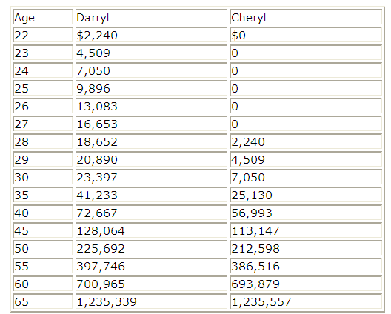
What does this tell you?

Slide 8
The Power of Compounding !
The chart on the previous slide shows the value of Darryl's and Cheryl's respective IRAs, from the time they are 22 years old all the way
to 65.
  Darryl's total investment is $12,000
  ($2,000 /yr. for the first 6 yrs)
  Cheryl's total investment is $74,000
  ($2,000/yr. for the last 37 yrs).
* Source: http://www.mindyourfinances.com/money-management/savings/081104-04
=
=

Slide 9
Financial Freedom is…
Financial independence – “the state of having sufficient personal wealth to live indefinitely without having to work actively for basic necessities” –Wikipedia.com
How do I get There?
  12 Steps to Financial Freedom
  G.O. Activity
    located in Shared Drive

Slide 10
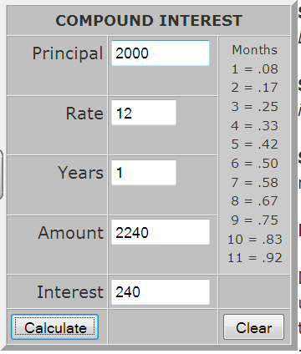
What!!!! You Don’t Believe Me?

Slide 11

Basic Savings Options
Savings Account – Account that lets one safely store money for future needs and goals (NO risk what so ever, but what is the current rate of inflation?)
  Pros – Safe, Easy access (liquidity), Reliable Interest, short term savings needs
  Cons - Fees and minimum balance vary, lower interest rates (currently below 1 %)
Checking Account – bank account mainly used for paying bills and accessing cash
  Pros – Safe, Easiest access (with checks or debit cards) , Direct Deposit, record keeping accuracy
  Cons - Fees vary, most not interest earning
“ONE WAY DOOR” –most of the time
“TWO WAY DOOR”

Slide 12
Basic Savings Options –cont.
Money market account- a combination savings-investment plan in which $ deposited is used to purchase safe, liquid securities or for long term saving needs
  Pros – Higher Interest rate returns, great for long term goals
  Cons - Variable interest rate- up and down with stock market, larger minimum balance
  requirement
Certificate of deposit (CD)- a deposit that earns a fixed interest rate for a specified term
  Pros - higher interest rates, greater returns
  Cons - Less liquid, (Maturity date- the date on which an investment becomes due for payment),
  Penalty for early withdrawal

Slide 13
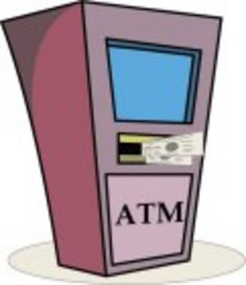
When Selecting a Bank consider…
Liquidity-how quickly and conveniently you can access your cash
  any cost?
Safety- insurance (FDIC)
  Up to $250,000 (back to $100,000 in 2014)
Convenience
  Location, products/services offered, hours, ATM’s
Interest Earning Potential (APY)
  Shop around for best rates (will be small, but better than 0)
Fees and Restrictions
  Minimum balance, withdrawal/ATM fees, etc
AND…

Slide 14
Savings Tips
Save Regularly!
  Set up a Direct Deposit relationship with your employer
    Paycheck AUTOMATICALLY deposited into your bank account
Take out Automatic Payroll and Savings Deductions for LONG TERM Investing
  IRA (retirement) - tax deferred and Low Liquidity
    401K
    College Savings (Tap-529)
  Investing Account (Stocks and Mutual Funds)
Shop Wisely
  Buy Needs, NOT WANTS
  Use your Phone! (Get the APPS!)
Pay
Yourself First!!!

Slide 15


Slide 16
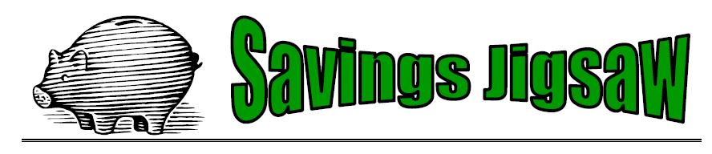
Get Researching!

Slide 17
Savings Tips
Save Regularly!
  Set up a Direct Deposit relationship with your employer
  Paycheck AUTOMATICALLY deposited into your bank account
Take out Automatic Payroll and Savings Deductions for LONG TERM Investing
  IRA (retirement) - tax deferred and Low Liquidity
    401K
    College Savings (Tap-529)
  Investing Account (Stocks and Mutual Funds)
Shop Wisely
  Buy Needs, NOT WANTS
  Use your Phone! (Get the APPS!)
Pay Yourself!!!

Slide 18
Savings vs. Investing
INVESTING
SAVING
Directions: Create a basic Venn diagram depicting the basic differences and similarities between saving and investing.

